Slide 1
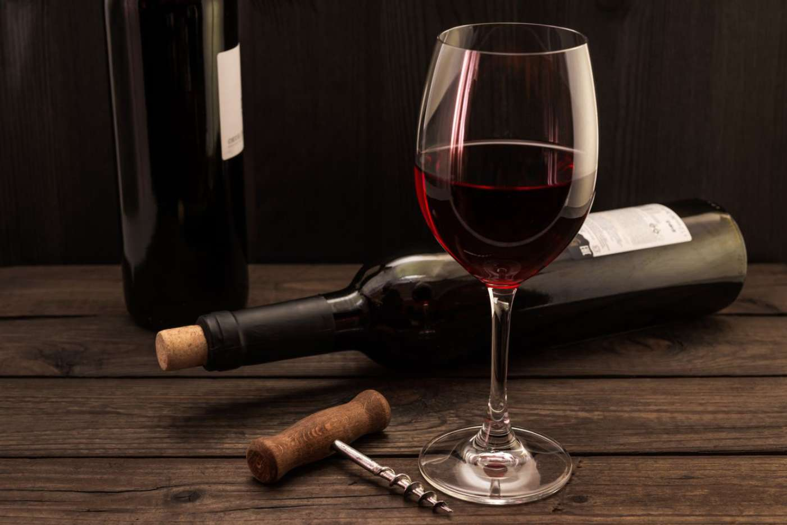
Capstone project Wine quality prediction
Done by :
Arun G K
+91 7598409963
arungk.63@gmail.com

Slide 2
Problem statement and understanding
Objective
To predict the wine quality using the machine learning algorithm.
Study the variables in the data set like fixed acidity, volatile acidity, alcohol content etc. Brief description shared along with data is given in the table below
Analyze these data through classifier algorithm and predict the quality of wine on score from 3 to 8 or bad-good .check the output obtained through the model for correctness and optimize the model based on performance
Three Machine learning classification algorithms are considered in this project
Random forest
Logistic regression
Naive bayes
No | Attributes | Description
1 | pH | To measure ripeness
2 | Density | Density in gram per cm3
3 | Alcohol | Volume of alcohol in percentage
4 | Fixed Acidity | Impart sourness and resist microbial infection, measured in no. of grams of tartaric acid per dm3
5 | Volatile Acidity | No. of grams of acetic acid per dm3 of wine
6 | Citric Acid | No. of grams of citric acid per dm3 of wine
7 | Residual Sugar | Remaining sugar after fermentation stops
8 | Chlorides | No. of grams of sodium chloride per dm3 of wine
9 | Free sulfur dioxide | No of grams of free sulfites per dm3 of wine
10 | Total Sulfur dioxide | No of grams of total sulfites (free sulfite + bound)
11 | Sulphates | No of grams of potassium sulphate per dm3 of wine
12 | Quality | Target variable 3-8 value

Slide 3
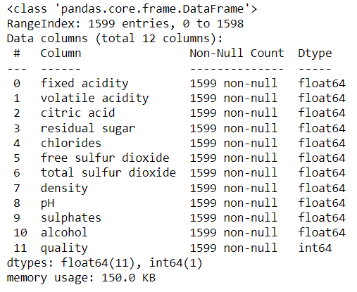
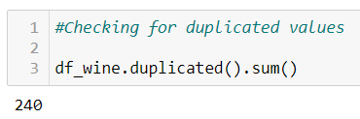
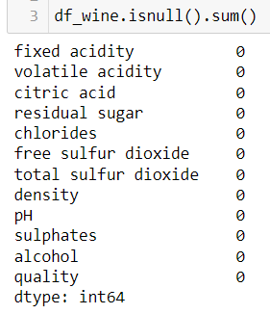
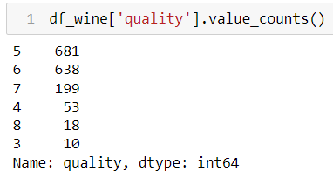
Preliminary observations in the data
There are 12 variables and 1599 samples
Data type of 11 variables are ‘float’ and of variable quality is ‘int’.
There is no null values in the data.
There are 240 duplicate data present. Removed duplicates from the data.
Quality is target variable and we need to predict quality based other 11 variables.
So quality can be considered as independent variable and others can be considered a depended variable for model.
The count of extreme poor quality (3) and extreme good quality (8) are very less compared to other quality range

Slide 4
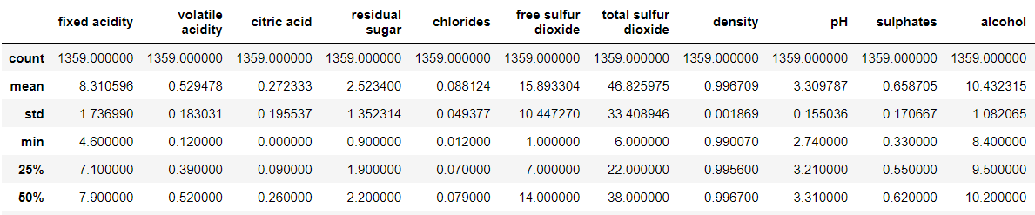
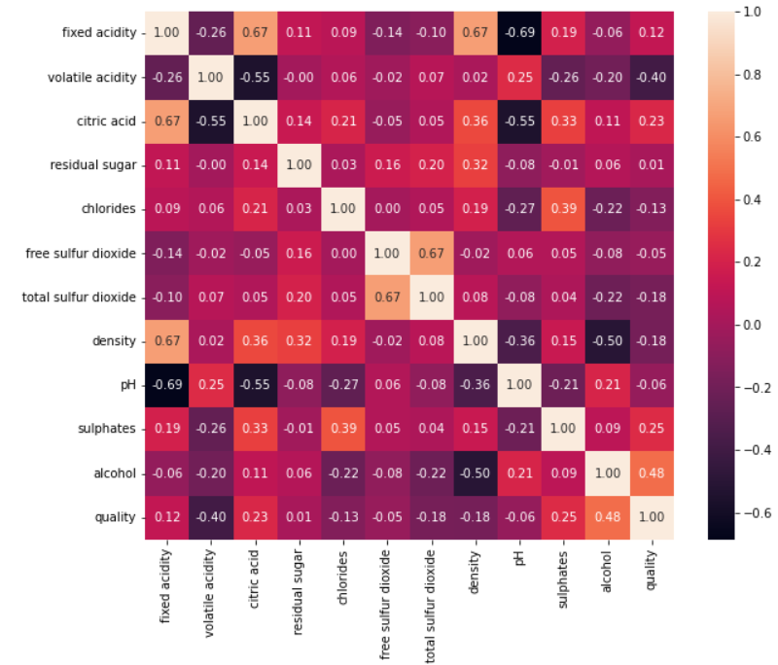
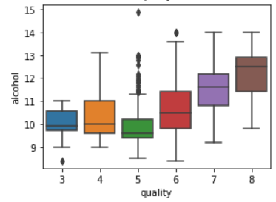
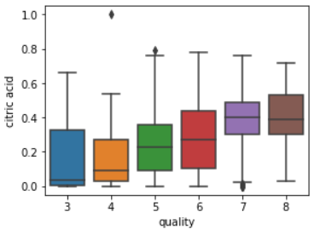
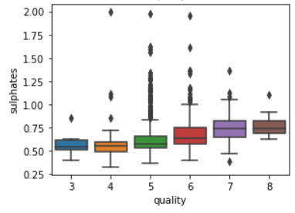
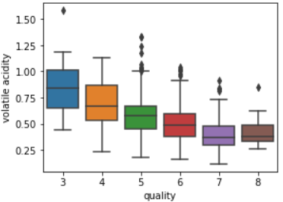
Exploratory Data Analysis (EDA)
Max positive correlation value is 0.48 (between Alcohol content and quality) and max negative correlation value is -0.40(between volatile acidity and quality)
From boxplot also it is observed that quality is improving with alcohol content and with the increase of volatile acidity the quality of wine is reducing.
It is also observed that with increase in citric acid and sulphate quantity the quality improving.

Slide 5
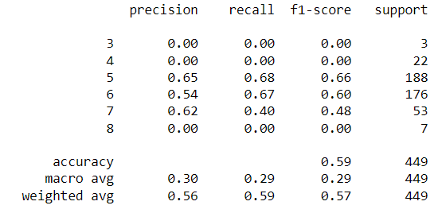
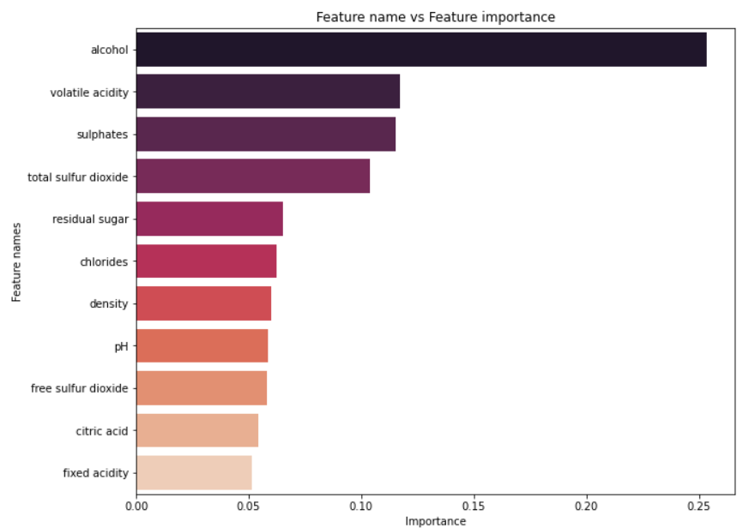
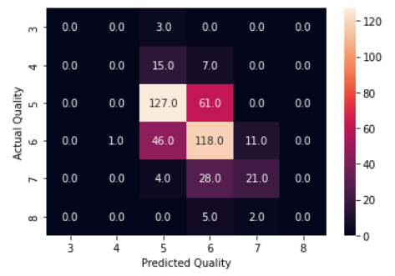
Prediction of wine quality using Random forest ML algorithm
Data first trained with a multiclass classification algorithm ie. Random forest, The target variable have the class values from 3 to 8 ,which indicate the quality of the wine.
Train test split done with ratio 2/3 and 1/3 respectively.
Hyper parameters are optimized using grid search cv and the optimized values used in the model ( bootstrap': True, 'criterion': 'gini', 'max_depth': 8, 'max_features': None, 'min_samples_leaf’: 1)
Optimum value of n_estimator :800 (number of trees) is found by iterating through the range 10-1200 with min value of oob error.
Evolution of model is done with confusion matrix and accuracy score.
The trained model gave a accuracy of 0.59 with test data.
Feature importance is checked with the model and plotted in descending order. Classification report is checked to get the summary of model performance.

Slide 6
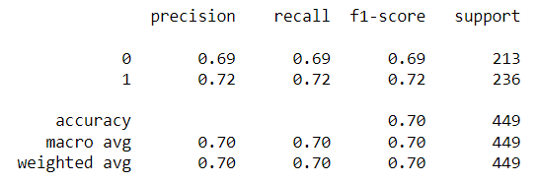
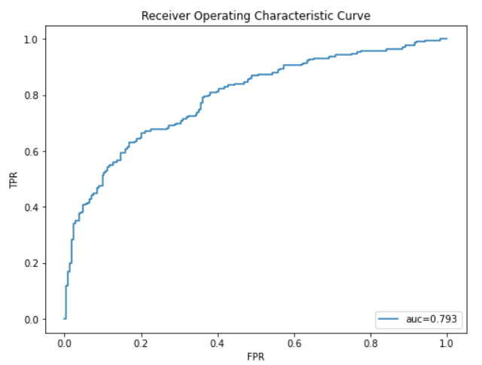
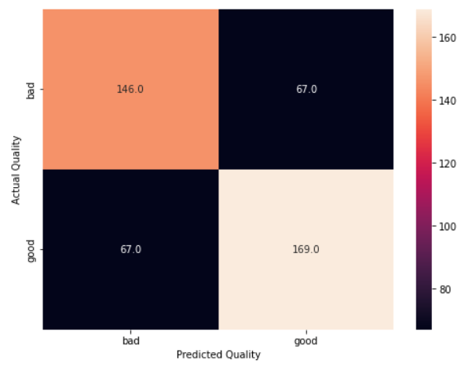
Prediction of wine quality using Logistic Regression ML algorithm
Data trained with binary classification algorithm ie. Logical regression, The target variable is considered and binary class good and bad. It is done by considering quality 3 to 5 as ‘bad quality’[0] and 5 to 8 as ‘good quality [1]
Train test split done with ratio 2/3 and 1/3 respectively.
Data standardization done using standard scalar
Evolution of model is done with confusion matrix, accuracy score, recall score and precision score.
The trained model gave a accuracy of 0.70 with test data.
ROC is plotted and AUC is calculated to check the performance of the model

Slide 7
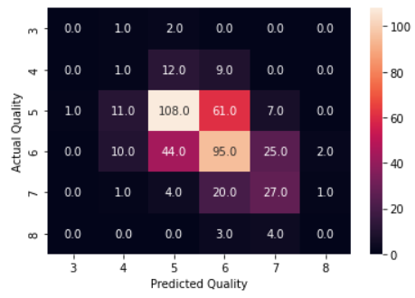
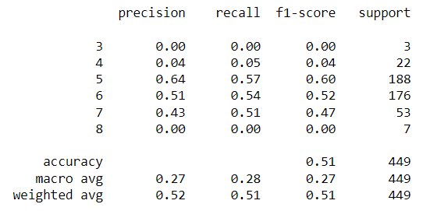
Prediction of wine quality using Naive Bayes ML algorithm
Data trained with Naive Bayes algorithm, The target variable have the class values from 3 to 8 ,which indicate the quality of the wine
Train test split done with ratio 2/3 and 1/3 respectively.
Evolution of model is done with confusion matrix and accuracy score, recall score and precision score.
The trained model gave a accuracy of 0.51 with test data.
Conclusion
Out of 3 Machine learning models Logistic regression giving the best accuracy with value 0.70.
Considering multiclass classification model Random forest giving the better accuracy ( 0.59) compared to Naive bayes.

